Slide 1
Introduction to Git, Node and React
By :
Gira Patel
Lecturer,Bhagwan Polytechnic

Slide 2
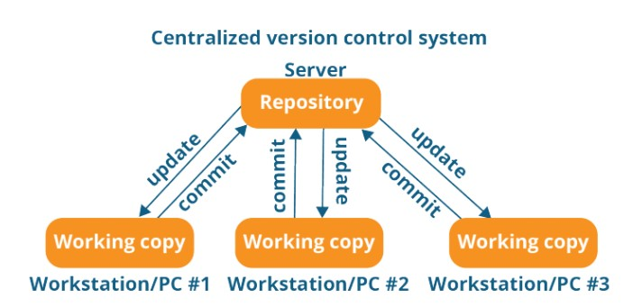
Centralized Version Control System

Slide 3
What is Git?
There are two types of version control system:
Centralized Version Control System
Distributed Version Control System

Slide 4
Drawback
It is not locally available; meaning you always need to be connected to a network to perform any action.
Since everything is centralized, in any case of the central server getting crashed or corrupted will result in losing the entire data of the project.

Slide 5
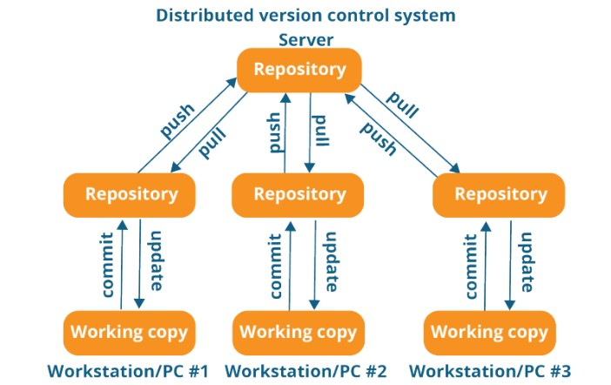
Distributed Version Control System
Pull - > update their local repository with new data from central repository
Push - > change / update main repository

Slide 6
Advantages
All operations (except push & pull) are very fast because the tool only needs to access the hard drive, not a remote server. Hence, you do not always need an internet connection.
Committing new change-sets can be done locally without manipulating the data on the main repository. Once you have a group of change-sets ready, you can push them all at once.
Since every contributor has a full copy of the project repository, they can share changes with one another if they want to get some feedback before affecting changes in the main repository.
If the central server gets crashed at any point of time, the lost data can be easily recovered from any one of the contributor’s local repositories.

Slide 7
Git is an open-source distributed version control system.
It was developed in 2005 by Linus Torvalds, the creator of the Linux operating system kernel.
It is used for tracking changes in the source code during software development.

